Slide 1
Part 1, Video 1: Introduction to Non-Relational Data Models
Agenda:
Limitations of Relational databases
Current Pressures of Big Data
Four Alternative Data Store Technologies
In this video we review the current environmental conditions around big data and the limitations of relational databases in order to set the stage for our exploration of four alternative data models: Document Store, Key-Value Store, Column Store, Graph Store
Remember – I’ll often use “store,” “data store,” and “database” interchangeably as I describe these alternatives. I may also refer to them as types of data models.

Slide 2
Data Storage Landscape
Operational Needs
Analytical Needs
Transactional Databases
Data Warehouses
Relational Databases
Data Lakes
Non-Relational Technologies
Alternative Data Stores

Slide 3
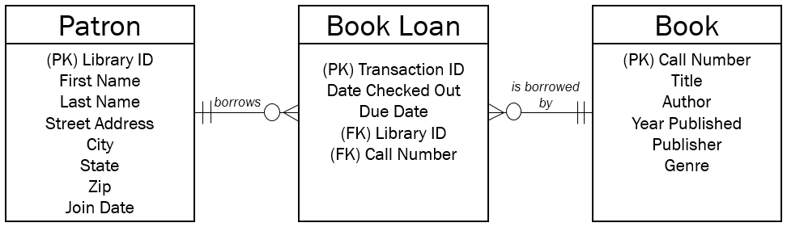
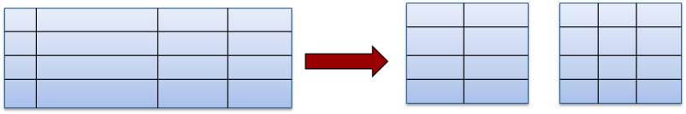
A relational database is a database that stores both
data and the relationship between pieces of data.
Normalization is the process of organizing a relational database to minimize redundancy and data dependencies. It is a principle that optimizes operational transactions.
Normalization

Slide 4
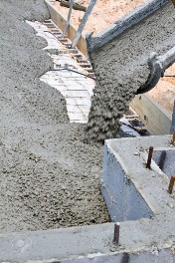
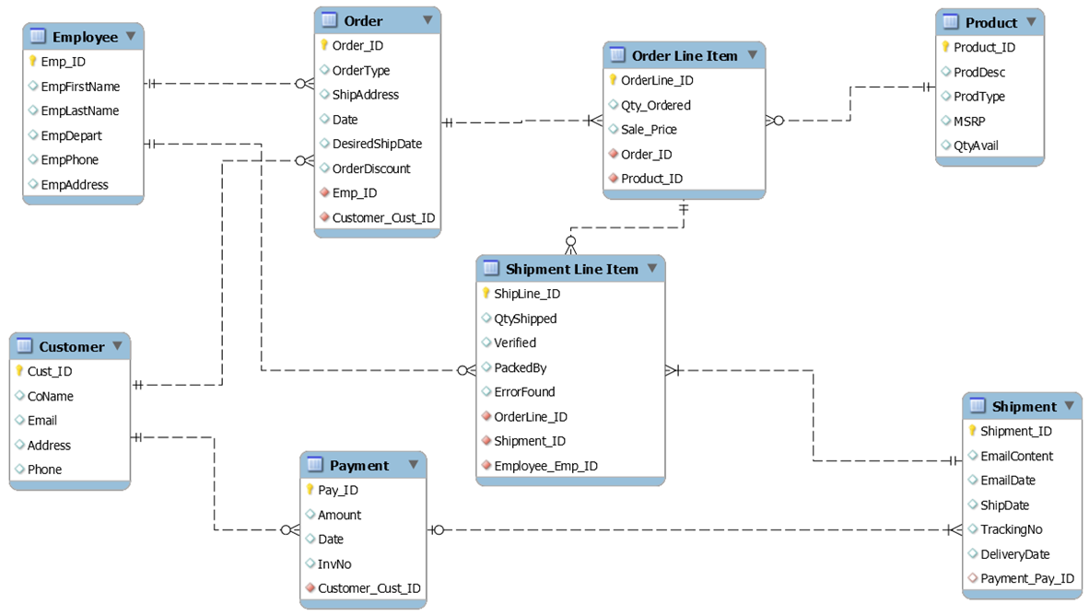
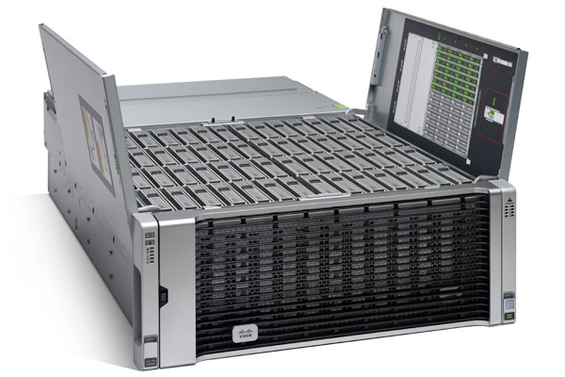

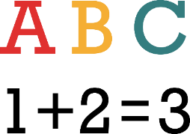

Limitations of Relational Databases
Cost of Structure
Cost of Storage
Cost of Standard Data Types

Slide 5
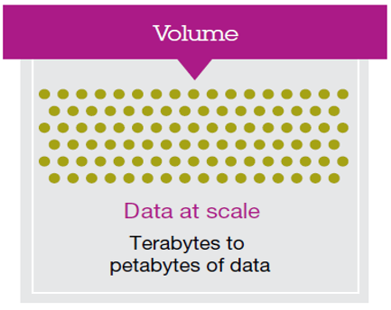
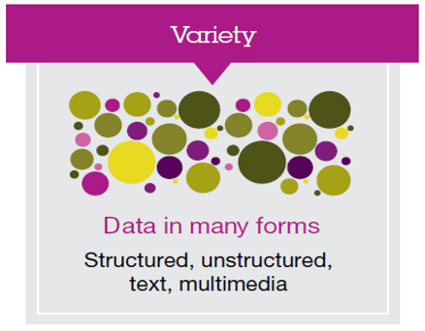
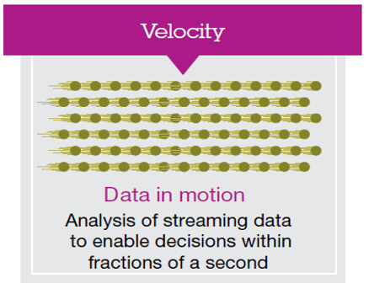
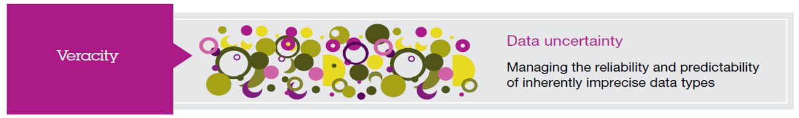
Current Pressures of Big Data
Notes:
We also know…

Slide 6
Alternative Data Storage Technologies
NoSQL
“Not Only SQL”
“NoSQL Databases”
SQL
“SQL Databases”

Slide 7

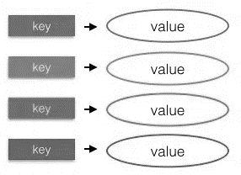
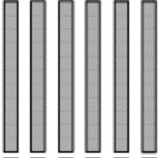
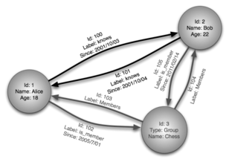
Alternative Data Storage Technologies
Document Store
Key/Value Store
Relational Database Model
Column Store
Graph Store

Slide 8

NoSQL Technologies
How do they differ in the way they store data?
What size data can the data model choice handle? Is it Scale-Out or Scale-Up?
What are the advantages, what are the disadvantages?

Slide 9
Alternative Data Storage Technologies
Document Store
Key/Value Store
Relational Database Model
Column Store
Graph Store

Slide 10
Part 1, Video 2: Document Store
Agenda:
Provide a Description of the Alternative Data Model
Describe it via the set of Data Model Traits
In this video we explore document store, and in order to set a baseline we also compare this alternative data store form to relational databases.

Slide 11
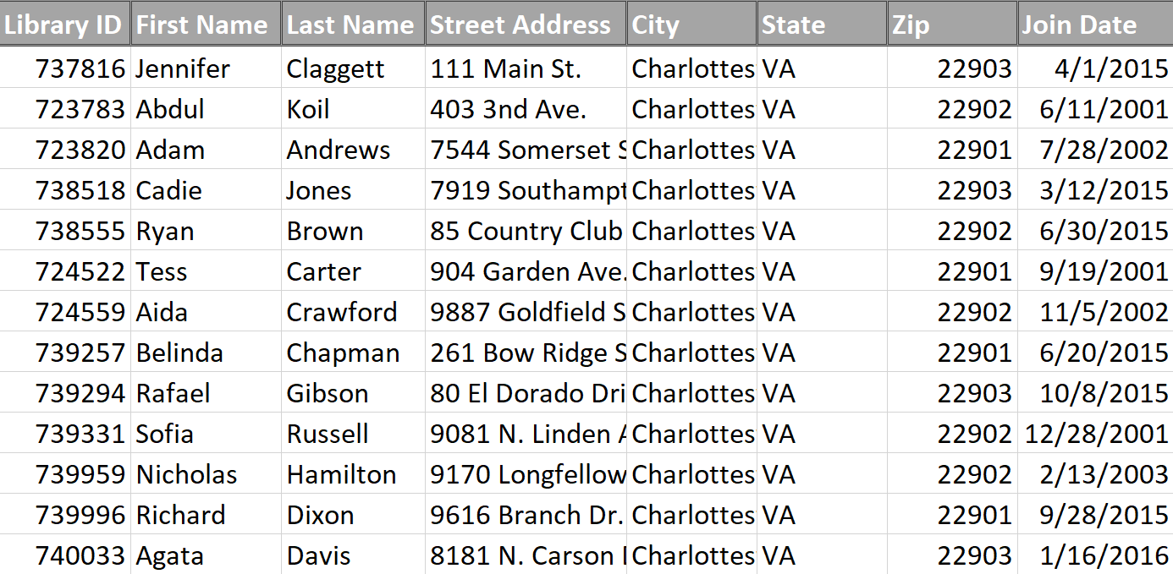
Relational Database
Columns
Rows

Slide 12
Summary of Data Storage Choices
 | Relational Databases | Document-Oriented Databases
Storage Constructs | Rows & Columns in Tabular Format Defined by Rigid Schemas, Specified in Advance
Data | Suited for Homogenous Data Attributes Specified at Entity-Level
Optimal Max Size
Language
Pros
Cons
Good Example Use Cases

Slide 13
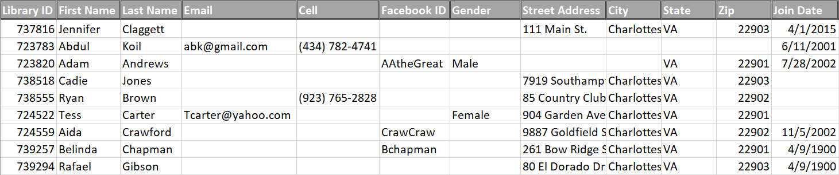
Heterogenous Data
Home Phone?
Date of Birth?

Slide 14
Document Store Data Model
{
“libraryID”: “737816”,
“firstName”: “Jennifer”,
“lastName”: “Claggett”,
“streetAddress”: “111 Main st.”
…other attributes…
}
{
“libraryID”: “723783”,
“firstName”: “Abdul”,
“lastName”: “Koil”,
“email”: “abk@gmail.com”
…other attributes…
}
{
“libraryID”: “723820”,
“firstName”: “Adam”,
“lastName”: “Andrews”,
“facebook”: “AAtheGreat”
…other attributes…
}

Slide 15
Document Store Data Model
Collections contain…
many Documents
{
“libraryID”: “737816”,
“firstName”: “Jennifer”,
“lastName”: “Claggett”,
“streetAddress”: “111 Main st.”
…other attributes…
}
You may have a collection of “Patrons” where each document contains information about one patron.

Slide 16
Summary of Data Storage Choices
 | Relational Databases | Document-Oriented Databases
Storage Constructs | Rows & Columns in Tabular Format Defined by Rigid Schemas, Specified in Advance | Collections of Documents Schema Not Specified in Advance Encoding Format (e.g., XML or JSON) Needed
Data | Suited for Homogenous Data Attributes Specified at Entity-Level | Suited for Heterogenous Data Attributes Specified at Document-Level (Entry Level)
Optimal Max Size | TB-level “Scale-Up” Growth, not “Scale-Out” | PB-level “Scale-Out” possible via distributed data
Language | SQL | NoSQL type varies, tends to be database specific
Pros
Cons
Good Example Use Cases

Slide 17
Example SQL vs. NoSQL Variant
SQL Statement | MongoDB commands
SELECT * FROM table | db.collection.find()
SELECT * FROM table WHERE lastName = ‘Claggett’ | db.collection.find({lastName:”Claggett”})
SELECT* FROM table ORDER BY Title | db.collection.find().sort(Title:1)
DISTINCT | .distinct()
GROUP BY | .group()
>=, < | $gte, $lt

Slide 18
Summary of Data Storage Choices
 | Relational Databases | Document-Oriented Databases
Storage Constructs | Rows & Columns in Tabular Format Defined by Rigid Schemas, Specified in Advance | Collections of Documents Schema Not Specified in Advance Encoding Format (e.g., XML or JSON) Needed
Data | Suited for Homogenous Data Attributes Specified at Entity-Level | Suited for Heterogenous Data Attributes Specified at Document-Level (Entry Level)
Optimal Max Size | TB-level “Scale-Up” Growth, not “Scale-Out” | PB-level “Scale-Out” possible via distributed data
Language | SQL | NoSQL type varies, tends to be database specific
Pros | Data consistency (one truth) and highly structured. | Efficient use of storing heterogenous data. Flexibility.
Cons | All data must have a pre-designed “spot” to exist in. Cost as size increases. | No capture of information about relationships between data.
Good Example Use Cases | Any standard transaction, especially financial, such as point-of-sales collection. Inventory management, etc. | Event Logging. Content Management Systems. Social Media Applications.

Slide 19
Part 1, Video 3: Key-Value Store
Agenda:
Provide a Description of the Alternative Data Model
Describe it via the set of Data Model Traits
In this video we explore key-value stores as an alternative way to store data.

Slide 20
Heterogenous Data

Slide 21
Key-Value Stores (or Databases)
Key/Value Store
Tables
Key
Value
A
1
A
2
Partition
A
B
1
“Entity”
Key…
Value…
Partition
B
2
Partition
B
Row

Slide 22
Summary of Data Model Traits
 | Key-Value Stores (or Databases)
Storage Constructs | Partitions Keys (made up of partition and row location) Values (all data stored for that entity) Schema Not Specified in Advance
Data
Optimal Max Size | PB-level “Scale-Out” possible via distributed data (thanks to partitions)
Language
Pros
Cons
Good Example Use Cases

Slide 23
Key-Value Stores (or Databases)
Key/Value Store
Tables
Key
Value
A
1
B
2
Application
A
2
Partition
A
B
2
B
1
“Entity”
Key…
Value…
Partition
B
2
Partition
B
Row

Slide 24
Key-Value Stores (or Databases)
Key/Value Store
Tables
Key
Value
A
1
B
2
Application
Name
Country
Age
Partition
A
A
2
B
2
String
String
int
Common Commands: Put, Get, Delete
Name
Country
Age
FirstUse
B
1
String
String
int
Date
“Entity”
Key…
Value…
Count
Last
Partition
B
2
Partition
B
int
Date
Row

Slide 25
Key-Value Stores (or Databases)
Key/Value Store
Tables
Key
Value
A
1
B
2
Application
Name
Country
Age
Partition
A
A
2
B
2
String
String
int
Values are opaque to the application.
Name
Country
Age
FirstUse
B
1
String
String
int
Date
“Entity”
Key…
Value…
Count
Last
Partition
B
2
Partition
B
int
Date
Row

Slide 26
Values returned opaque to application
Key
Value
A1
Tom Li, China, 32
A2
Jennifer Claggett, USA, 40, 3/1/2017
B1
Juan Carlos, Mexico, 22, 9/10/2019
B2
77, 1/1/2020
Meta data that may be included inside the value field is not used/consumed by the application. It is considered “typeless”. It is simply committed or returned via GET and PUT commands and the entire value is returned. That is what we mean by opaque.

Slide 27
Summary of Data Model Traits
 | Key-Value Stores (or Databases)
Storage Constructs | Partitions Keys (made up of partition and row location) Values (all data stored for that entity) Schema Not Specified in Advance
Data | Suited for Heterogenous Data Attributes or Meta-Data NOT used/understood by database application. Opaque
Optimal Max Size | PB-level “Scale-Out” possible via distributed data (thanks to partitions)
Language | NoSQL – Limited Commands
Pros | Simplicity, speed and scalability
Cons | Relationships not captured. Meta-Data is not “known” by the system, so queries are limited and secondary indexes are not possible.
Good Example Use Cases | Session information in web applications. For example, building a shopping carts view for an on-line buyer (NOT the financial transaction), on-line gaming session in a multi-player application.

Slide 28
Video 4: Column Value Store
Agenda:
Provide a Description of the Alternative Data Model
Describe it via the set of Data Model Traits
In this video we explore column value stores (also referred to as “column family store” sometimes).

Slide 29
Tables Typical of Relational Databases

Slide 30
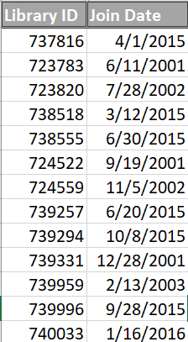
Column-Based Table Design

Slide 31
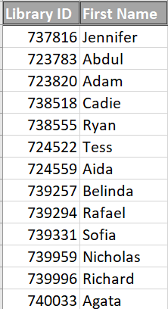
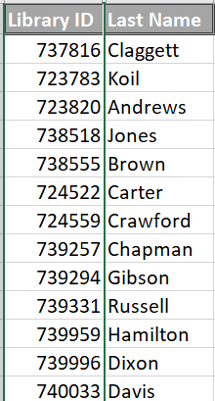
Column-Based Table Design

Slide 32
Two Basic Data Needs
Operational Needs
Analytical Needs
Day to day focus
Detailed data
Current / Snapshot
Queried rarely
Updated often
Common (write) access
Long time horizons
Aggregate data
Temporal questions
Queried often
Updated rarely (relative)
Limited access

Slide 33
Column Store Uses
Sacrifices an easy “whole entity” view. Rejoining columns to create that is costly.
Very efficient at analyzing join date!
Likely not worth the design sacrifice unless the row count is very high (many millions)

Slide 34
Summary of Data Model Traits
 | Column Stores (or Databases)
Storage Constructs | Tables Rows & Columns (Major emphasis on the Columns)
Data | A structured solution well suited for big data sets that have high analytical needs on certain columns.
Optimal Max Size | PB-level “Scale-Out” possible with most implementations
Language | Often SQL or a close variant, due to the similarity in structure to a relational database
Pros | Great at statistical operations of one commonly used column in a big data set. There are additional opportunities for compression due to the columns being of similar size (usually), which is advantageous given the size of the typical data sets that benefit from this model.
Cons | Terrible at reading or writing “complete records” of a complex entity (e.g., all attributes about a person or a transaction). This is because the siloed columns will have computationally expensive joins to recreate a complete view.
Good Example Use Cases | Big data sets that need frequent analyzing. For example, purchase order records where one or two fields are aggregated often.

Slide 35
Video 5: Graph Store
Agenda:
Provide a Description of the Alternative Data Model
Describe it via the set of Data Model Traits
In this video we explore graph stores as an alternative data model type.

Slide 36
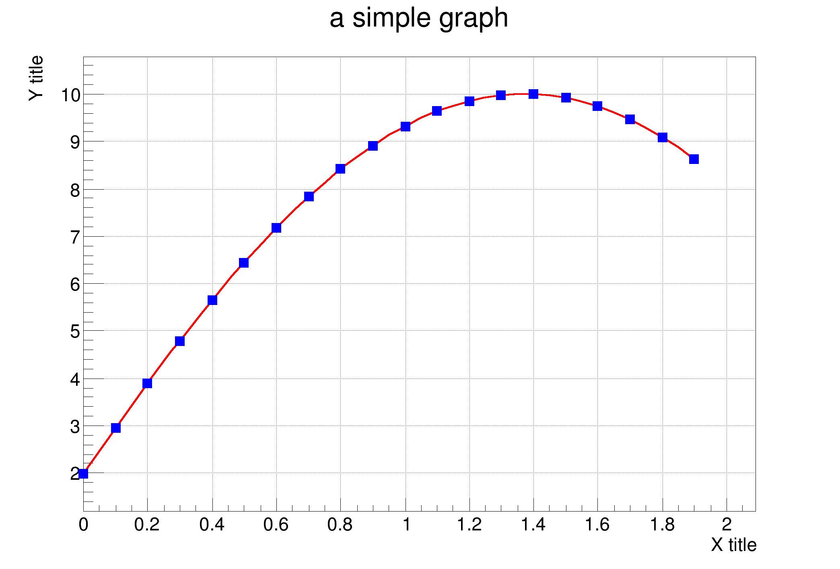
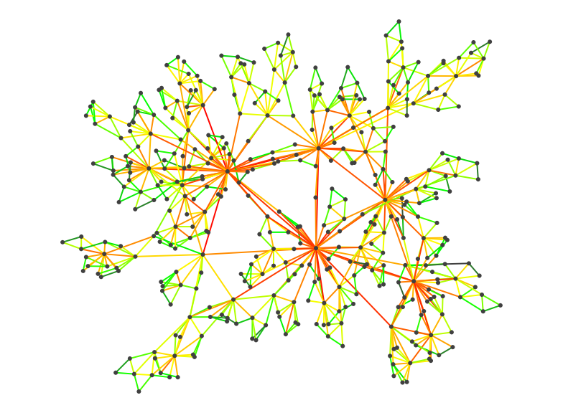
What do we mean by graph?

Slide 37
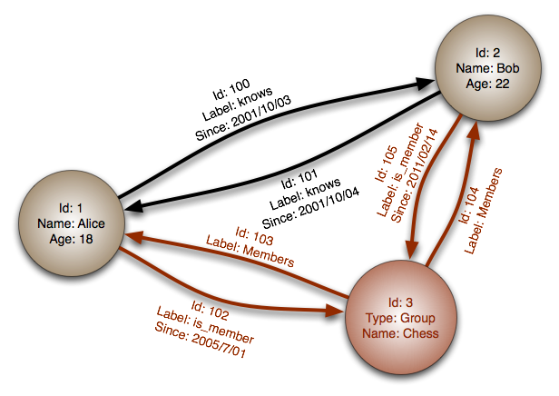
Classic Graph Data Example

Slide 38
Example in Relational Database
Player
Game
Player
Plays
Game

Slide 39
Classic Graph Data Example

Slide 40
Summary of Data Model Traits
 | Graph Stores (or Databases)
Storage Constructs | Nodes of Data Edges (Relationship Focused!)
Data | A conceptual data store that allows for individual relationships between specific entities to be recorded.
Optimal Max Size
Language
Pros
Cons
Good Example Use Cases

Slide 41
Classic Graph Data Example
You have data with relationships
You need a flexible schema to model them
Building a visual or conceptual map is useful

Slide 42
Summary of Data Model Traits
 | Graph Stores (or Databases)
Storage Constructs | Nodes of Data Edges (Relationship Focused!)
Data | A conceptual data store that allows for individual relationships between specific entities to be recorded.
Optimal Max Size | Dependent on Implementation (Often these rely on a secondary data model to store the nodes and edges)
Language | NoSQL varieties for Graph Stores are still quite disjointed and tend to be tied to a database vendor. Some even leverage a GUI interface through an API.
Pros | Relationship focused and flexible. You may explore the data and see insights you would not have been able to generate without the “relationship focused” vantage point.
Cons | May be computationally expensive and financially expensive, depending on how they’re built. Generally, they’re not major efficiency boosters.
Good Example Use Cases | Data sets that have important and varied relationships between the data pieces, such as social networks and customer-product use patterns. Some AI such as recommendation engines and fraud detection benefits from the relationship focus.
Notes:
Panama Papers…
https://neo4j.com/blog/analyzing-panama-papers-neo4j/

Slide 43
Video 6: Data Store Distinctions
Agenda:
Relationship Handling
Schema on Read or Write?
Heterogenous Data Efficiency
Querying the Data
So how do these four alternative data models stack up? As a way to summarize the lessons, I’m going to walk through several key data store traits and we’ll consider each of our data model types to assess their strengths and weaknesses.

Slide 44
Alternative Data Storage Technologies
Document Store
Key/Value Store
Relational Database Model
Column Store
Graph Store

Slide 45

Relationships
What is the relationship between your data?
Graph Store
Relationship details between nodes possible.
Relational Database Model
Column Store
Relationships defined between entities.
Document Store
Key/Value Store
Bottom of the pack…no relationships captured.

Slide 46
Schema on Read or Write?
When do you define your data structure?
Document Store
Key/Value Store
During analysis…on read.
Graph Store
Relational Database Model
Column Store
In advance…on write.

Slide 47
Heterogeneous Data Efficiency
Document Store
Key/Value Store
Graph Store
Relational Database Model
Column Store

Slide 48
Querying the Data (Meaningfully)
Will depend a lot on the meta-data captured, and the structure doesn’t naturally enforce it.
Document Store
Key/Value Store
Graph Store
Relational Database Model
Column Store
Structure lends itself to querying.

